Slide 1

Breaking Barriers: Real-Time Sign Language Recognition with CNNs
Priyal Madvi 22107020
Sneha Gupta 22107042
Ayush Gupta 23207007
Rushikesh Palekar 23207004
Project Guide
Prof. Aavani Nair

Slide 2
Outline
Introduction
Literature Survey of the existing systems
Limitations of the existing systems
Problem statement
System Design
Technologies and methodologies
Implementation
Conclusion
References

Slide 3
INTRODUCTION
AI-powered system for real-time sign language recognition.
Utilizes CNNs to interpret hand gestures accurately.
American sign language (ASL) to enhance communication through gesture-based interaction.
Enhances accessibility through real-time, AI-driven gesture analysis.
1.1 Motivation
Real-time sign language recognition fosters inclusivity by enabling seamless communication.
Utilizes CNNs to improve accessibility and reduce dependence on human interpreters.

Slide 4
1.2 Objectives
To accurately recognize the alphabet, convolutional neural networks (CNN) are effectively utilized in the process.
To detect hand from frame by using media pipe.
To efficiently form a message, convolutional neural networks are applied in the process.
To hear and deliver the message pyttsx3 library is used.
To translate recognized sentence into multiple languages,googletrans is utilized.
To save time, words are suggested using Enchant.

Slide 5
Literature Survey of the existing system
Sr. No | Title | Author | Year | Demerits | Methodology | Outcome
1 | [1] Design of Sign Language Recognition Using CNN | Citra Suardi, Anik Nur Handayani, Rosa Andrie Asmara, Aji Prasetya Wibawa, Lilis Nur Hayati, Huzain Azis | April 09 2022 | The system uses grayscale ,which may hinder its ability to properly detect hand gesture against a dark background. | Media pipe Landmark System | In our system,we are using Media pipe, which allow for the clear and accurate detection of each nerve point of the hand, even in dark background.

Slide 6
Literature Survey of the existing system
Sr. No | Title | Author | Year | Demerits | Methodology | Outcome
2 | [2] Hand Gesture Recognition for Sign Language Using Convolutional Neural Network | Dr.J Rethna Virgil Jeny, Anjana, Karnati Monica, Thandu Sumanth ,A Mamatha | August 19,2021 | The system does not save the speech file and sends on other systems. | pyttsx3 library | In our system, we provide saving and sending the Recognized speech file.

Slide 7
Literature Survey of the existing system
Sr. No | Title | Author | Year | Demerits | Methodology | Outcome
3 | [3]Sign Language Recognition Techniques- A Review | Mohammed Safeel , Tejas Sukumar , Shashank K S , Arman M D , Shashidhar R , Puneeth S B | Nov 6, 2020 | In this system, sentences are not translated into various languages, limiting the system's usability and accessibility. | googletrans library | In our system we provide the feature of translating sentences into various languages and the ability to read those sentences in different languages.

Slide 8
LIMITATION OF EXISTING SYSTEM
No Audio sending and saving support: Many systems lack audio support to save and send it if person is not present in front.
Translator: Existing systems do not offer a translator feature for converting message into several other languages also into different text.
Grayscale Images are utilized: Several systems rely on grayscale images, limiting performance in certain conditions such as poor background or no clear background.

Slide 9
Problem statement
Effective communication is crucial for individuals who are deaf or hard of hearing, yet many struggle with limited access to reliable tools for real-time sign language recognition.
Existing systems often lack accuracy, real-time processing, or the ability to interpret a wide variety of gestures, creating barriers to smooth communication.
This gap can lead to misunderstandings, isolation, and reduced opportunities for social and professional integration.

Slide 10
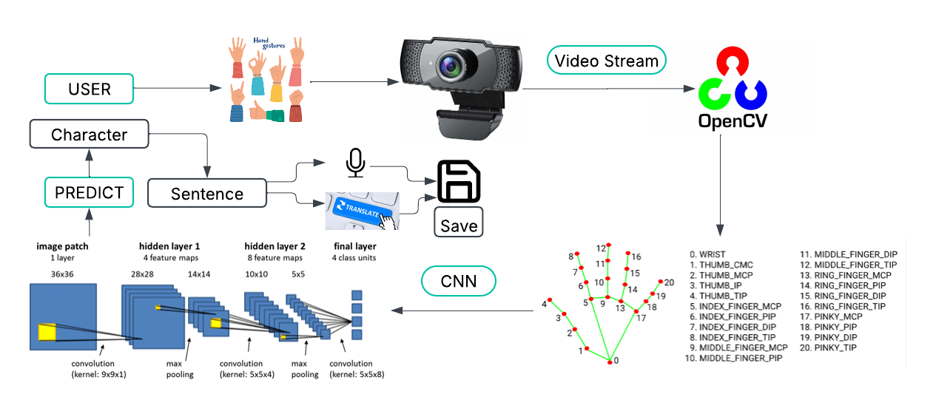
System Design

Slide 11
Technologies and methodologies
Hardware :
Webcam
Software :
Python (3.11.0)
PyCharm
Python libraries: OpenCV, NumPy, Keras , media pipe, Tensorflow
Methodology
CNNs (Convolutional Neural Network)
Datasets
A to Z (each contain 180 skeleton images) 68x69

Slide 12
Implementation

Slide 13
Implementation

Slide 14
Conclusion
Breaking Barriers seeks to bridge the communication gap for individuals who rely on sign language . By harnessing the power of convolutional neural networks, our system offers accurate, real-time detection, enabling smoother and more inclusive interactions.
This technology not only empowers the deaf and hard-of-hearing community but also promotes greater social integration and accessibility, paving the way for a more connected and understanding society.

Slide 15
References
[1]Citra Suardi, Anik Nur Handayani, Rosa Andrie Asmara, Aji
Prasetya Wibawa, Lilis Nur Hayati, Huzain Azis, 'Design of Sign
Language Recognition Using E-CNN',April 09-11-2022.
[2]Dr.J Rethna Virgil Jeny, A Anjana, Karnati Monica, Thandu Sumanth ,A Mamatha , 'Hand Gesture Recognition for Sign Language Using Convolutional Neural Network',August 19,2021.
[3]Mohammed Safeel , Tejas Sukumar , Shashank K S , Arman M D , Shashidhar R , Puneeth S B, 'Sign Language Recognition Techniques Using CNN' , Nov 6,2020.

Slide 16
Thank You...!!

